Slide 1
FIU GPA TRACKER AND FORECASTER
Juan Machado, Developer
Ike Ukachi Lois, Developer
Johann Henao, Product Owner
Masoud Sadjadi, Professor

Slide 2
Problem Definition
Students are not aware of GPA needed to to get into certain graduate programs.
Students are uncertain of what they need to earn to achieve a certain GPA.
When students have taken several courses GPA calculation becomes tedious.
Students might have trouble knowing where they stand academically during the semester.

Slide 3
Current System
PantherSoft allows students to view their GPA but does not tell them what grades they need to achieve a certain GPA or what they need to get into graduate programs.
To determine what GPA they need they need to look up graduate requirements and calculate by hand.
Professors may opt to use Moodle to post grades but many choose not to or take a long time to post grades.

Slide 4
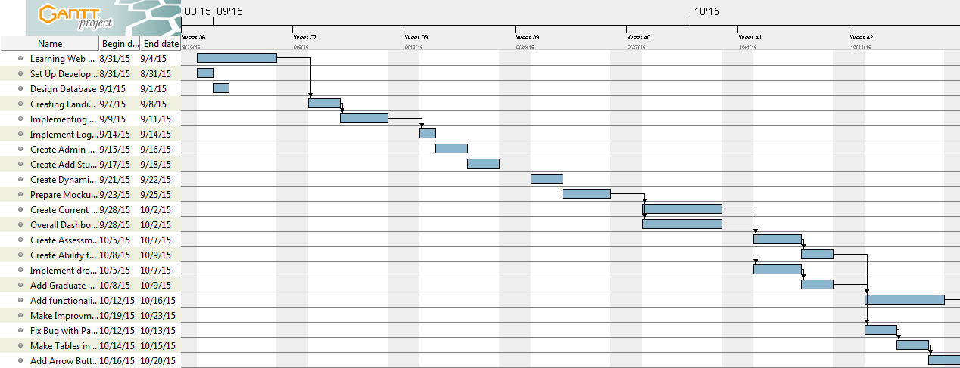
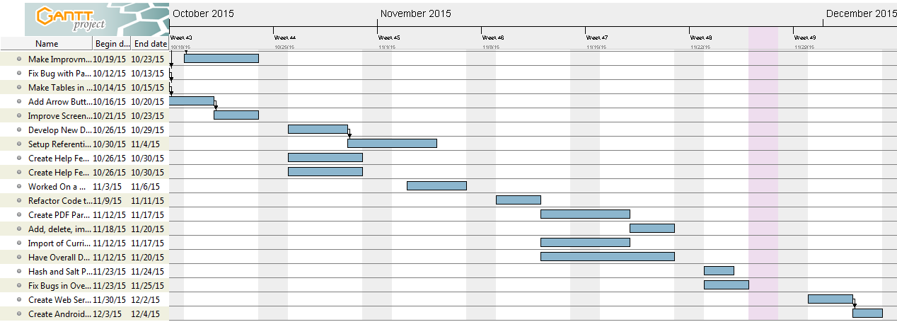
Project Management

Slide 5
User Stories Implemented
EPIC: Overall GPA Dashboard
EPIC:Semester Dashboard
Leverage "what if" feature to automate curriculum data import
Setup development environment and create Web Services and Android Development
Create an Android Mobile App to allow students to interact with Current Semester Grades

Slide 6
Use Case Diagram

Slide 7
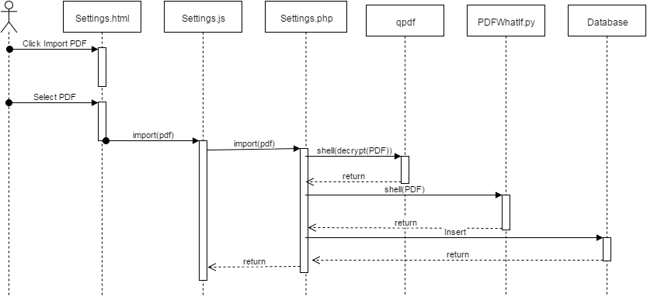
UML Sequence Diagram of Uploading Grade Report

Slide 8
UML Sequence Diagram of Adding a Course

Slide 9
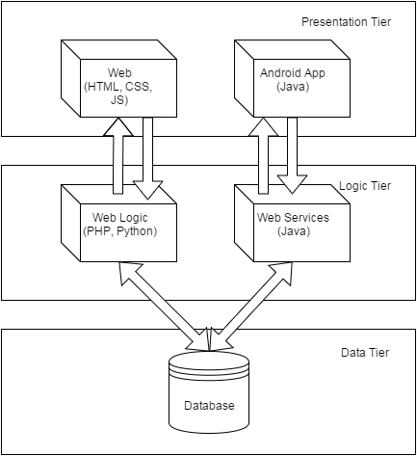
System Decomposition

Slide 10
H/W and S/W Requirements
Most server side code is done on Linux using mySQL, apache, and PHP.
Must be able to run most recent version of PHP as earlier versions might not support ajax calls.
Python was used for Parsing the GPA Audit.
PyPDF2 has to be installed to use the python script to parse and import a pdf
WebService Development was mainly done on Windows using Eclipse.
Android development was also done on Windows using AndroidStudio.
On the Client Side, the browser being used must support Ajax.
Our Android app supports any version of Android greater than 1.8.

Slide 11
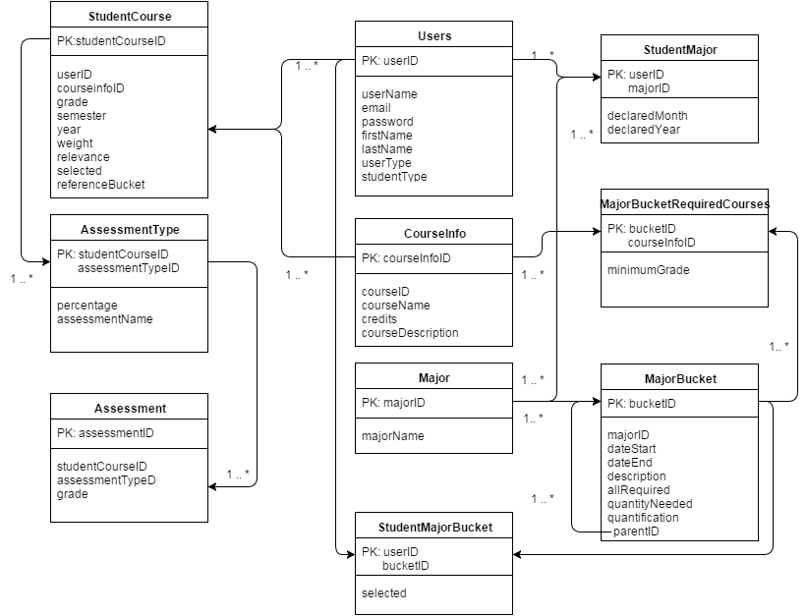
Persistent Data Design

Slide 12
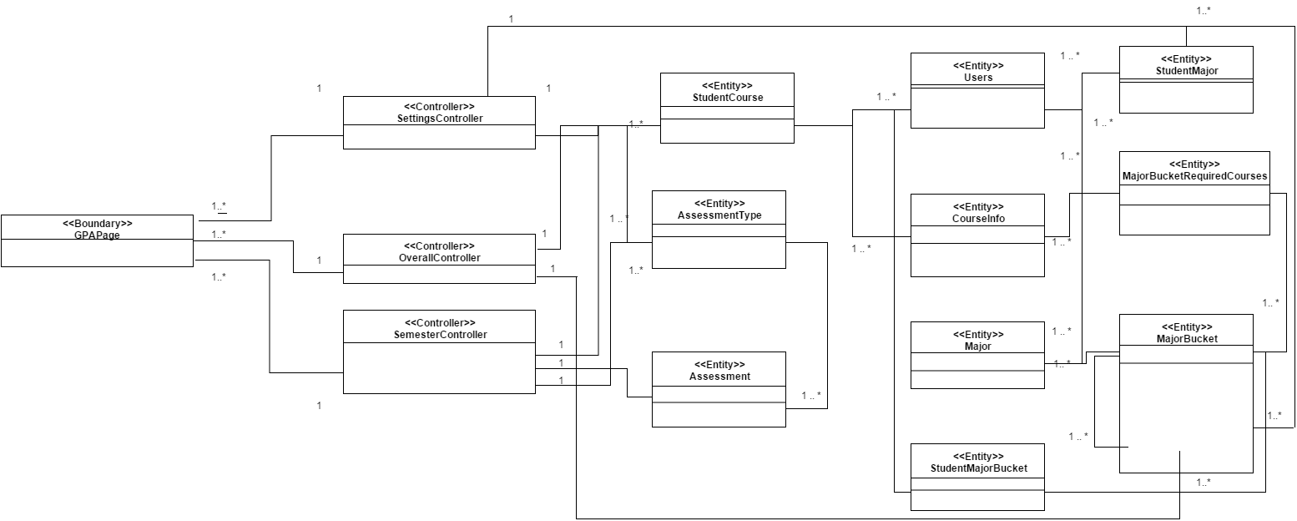
Minimal Class Diagram

Slide 13
Security
To prevent a dictionary attack all passwords have cryptographic salt concatenated to them and then salted.
SQL injections are avoided by using prepared statements for all mySQL queries.
A special secure user with restricted rights was created to handle inserts, updates, and selecting. It has no drop privileges.
Every failed attempted login is logged.

Slide 14
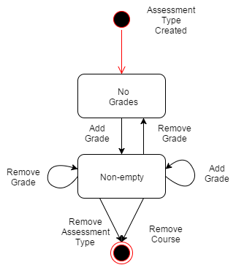
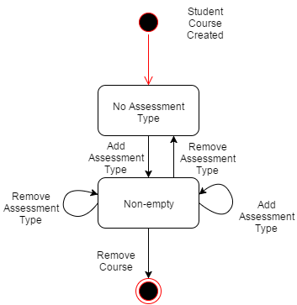
State Machine

Slide 15
Main Algorithm
For every enrolled course a student has there is a list of assessment types. Assessment types are like buckets of grades that all carry the same value like “Homework” or “Quizzes”.
Assessment types themselves are a collection of grades.
Initially a course has no assessment type.
A student can add an assessment type and specify how much it is worth.
Each assessment type is empty upon creation.
In each assessment type, they can add grades that correspond to that assessment type.
Any assessment type or grade can be removed at any moment.

Slide 16
Sunny Day Test Cases
Test Case Id | AddAssessmentType01
Purpose | Test if user can add an assessment type correctly.
Test Setup | User is logged in. They are in assessment breakdown page for a course with no assessment types.
Input | The user hits the add assessment button. Under assessment type, the user types in “homework”. Under percentage, the user types in 30. The user hits ok.
Expected Output | A new tab will appear with the name homework. When clicked an empty data table will appear.

Slide 17
Rainy Day Test Case
Test Case Id | AddAssessmentType02
Purpose | Test if the system prevents user from producing two assessment types under the same name.
Test Setup | User is logged in. They are in assessment breakdown page for a course with one assessment type called “homework”.
Input | The user hits the add assessment button. Under assessment type, the user types in “homework”. Under percentage, the user types in 30. The user hits ok.
Expected Output | An error message will appear indicating that the user cannot have two assessment types of the same name.

